Slide 1
All About Me
Isobel k

Slide 2
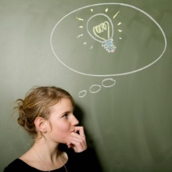
My Top 4 Intelligences:

Slide 3
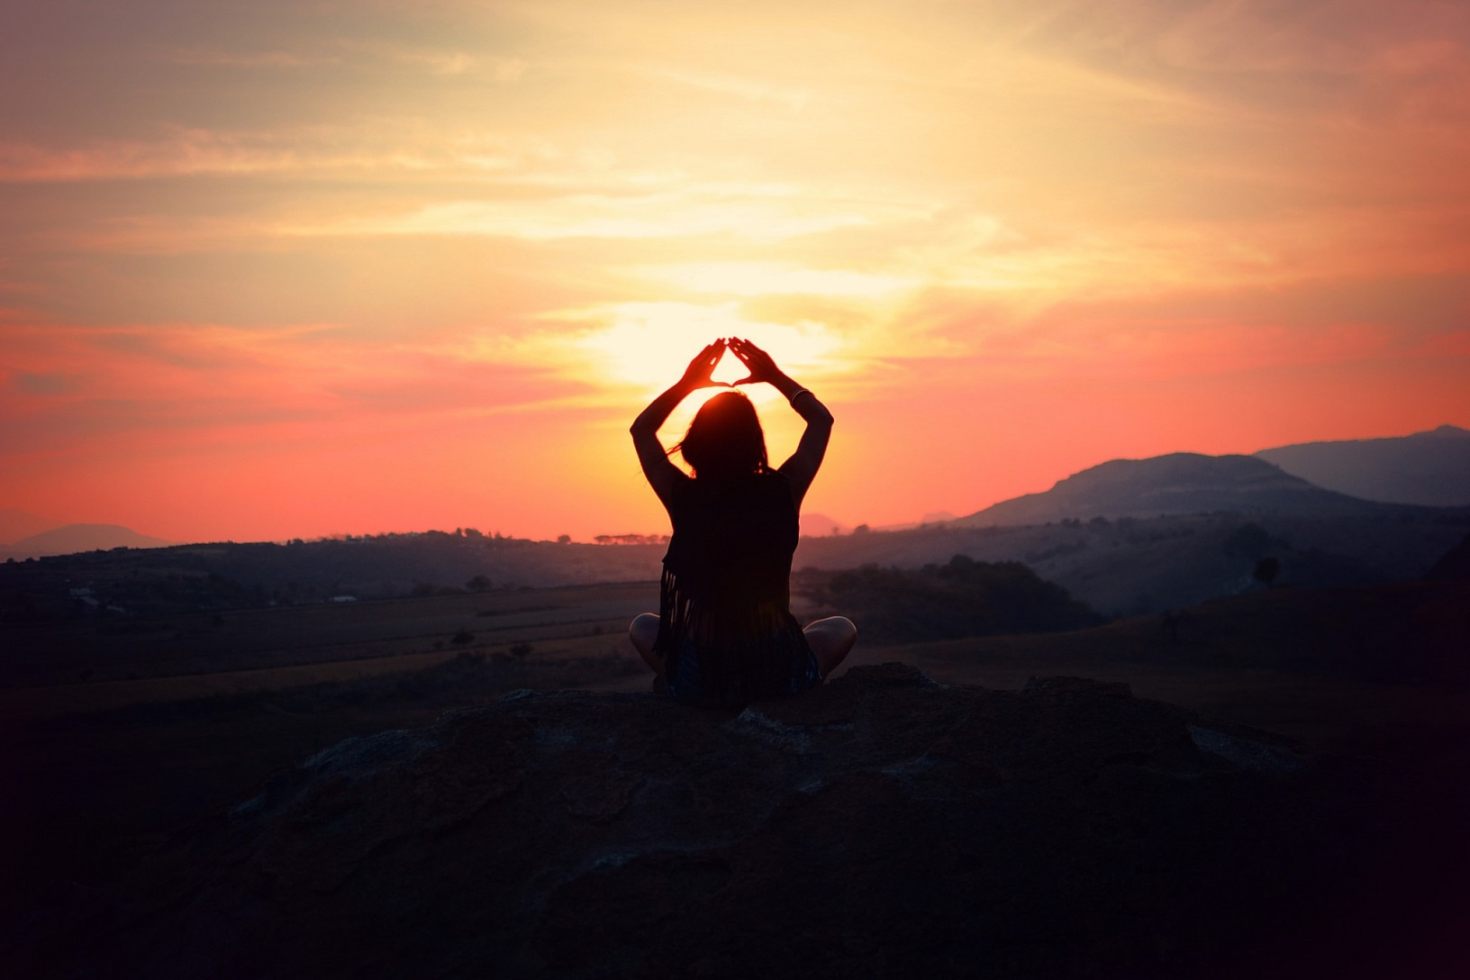
Intrapersonal (self)

Slide 4
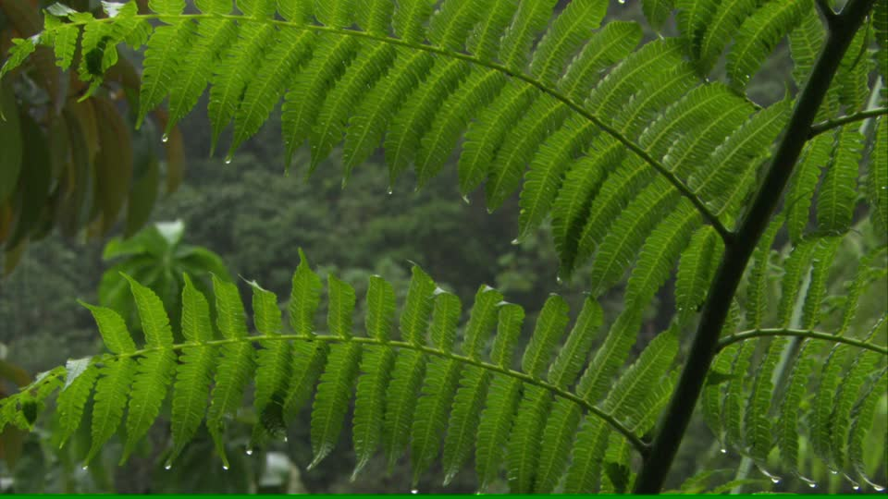
Naturalist (Nature)

Slide 5
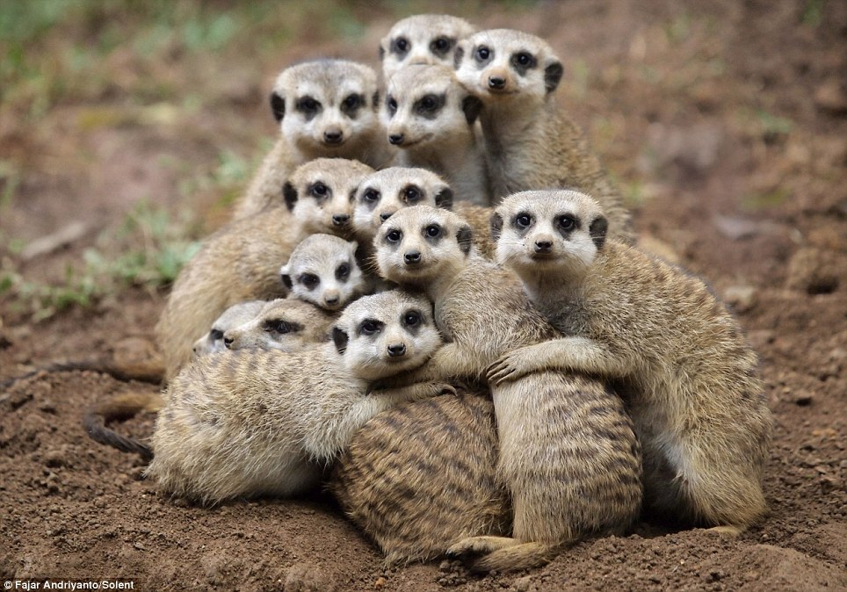
Interpersonal (Social)

Slide 6
Other Intelligences & Scores:
Kinesthetic
Linguistic
Spatial
Musical
Logic / Math

Slide 7
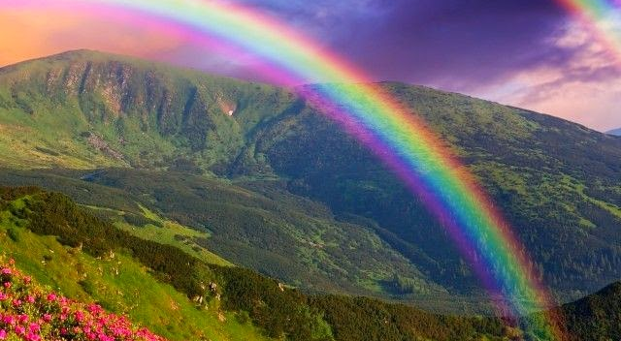
My True Colours:

Slide 8
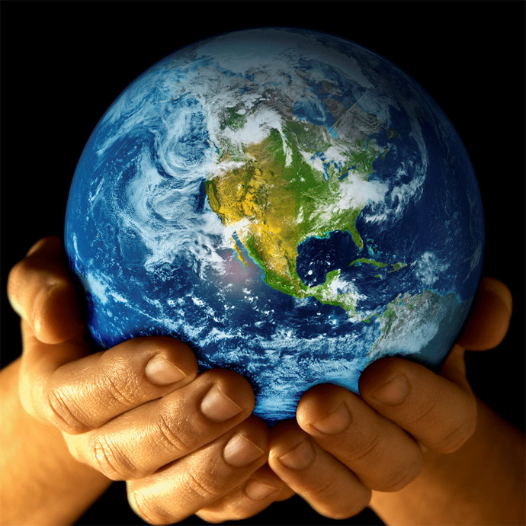
#1 - Blue
Friendly
Sensitive
Communicative
Creating harmony

Slide 9
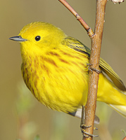
#2 - Gold
- Organized
Dependable
Value rules / structure

Slide 10
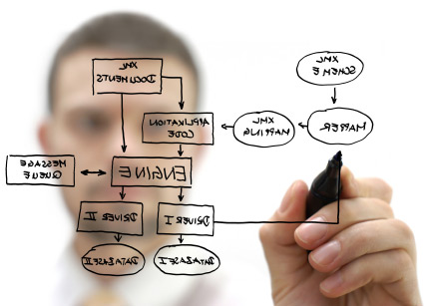
#3 - Green
Analytical
Logical
Independent
Thinks a lot

Slide 11
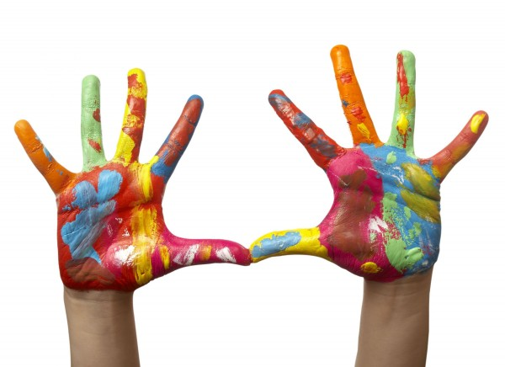
#4 - Orange
Competitive
Risk taking
Fun loving
Hands on

Slide 12

Top 5 Hobbies:

Slide 13
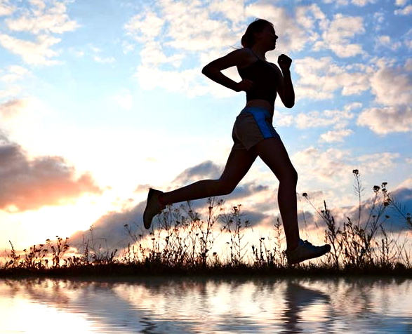
Running

Slide 14
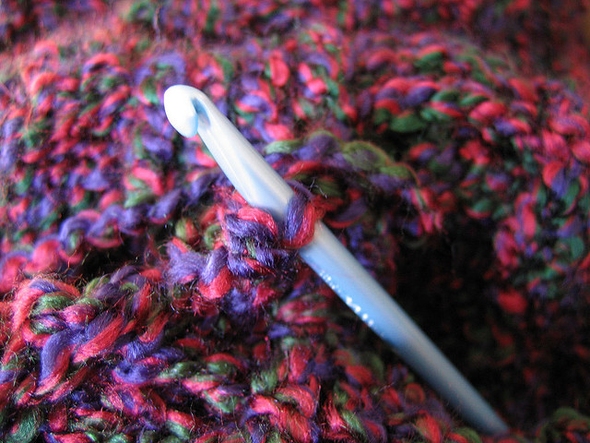
Crocheting

Slide 15
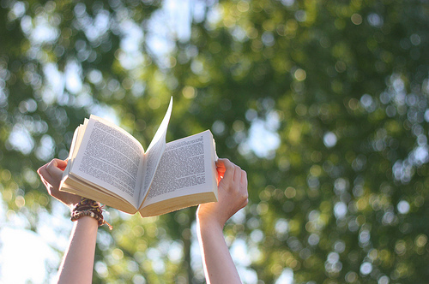
Reading

Slide 16
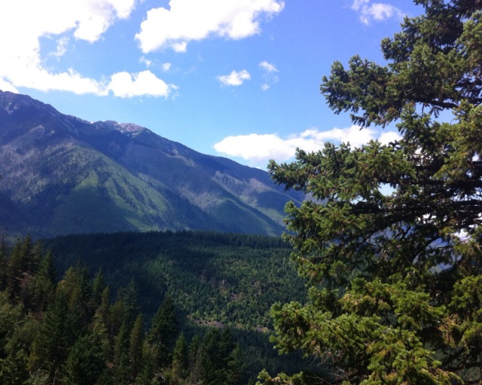
Hiking

Slide 17
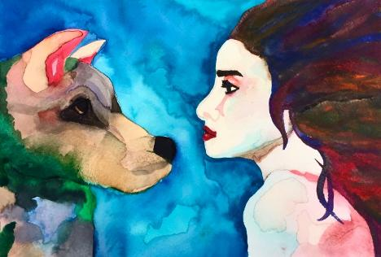
Drawing and Painting

Slide 18
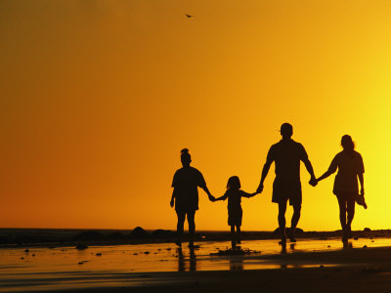
Role Model:

Slide 19
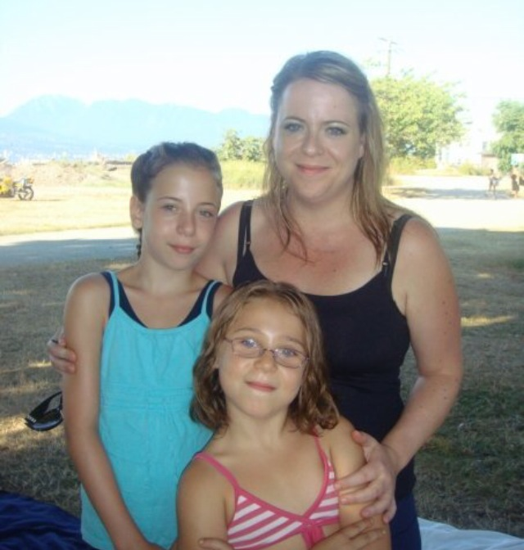
My Mum

Slide 20
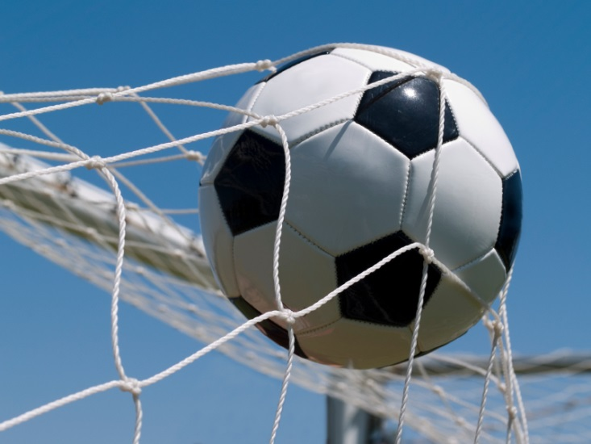
Top 5 Goals For The Next Year:

Slide 21
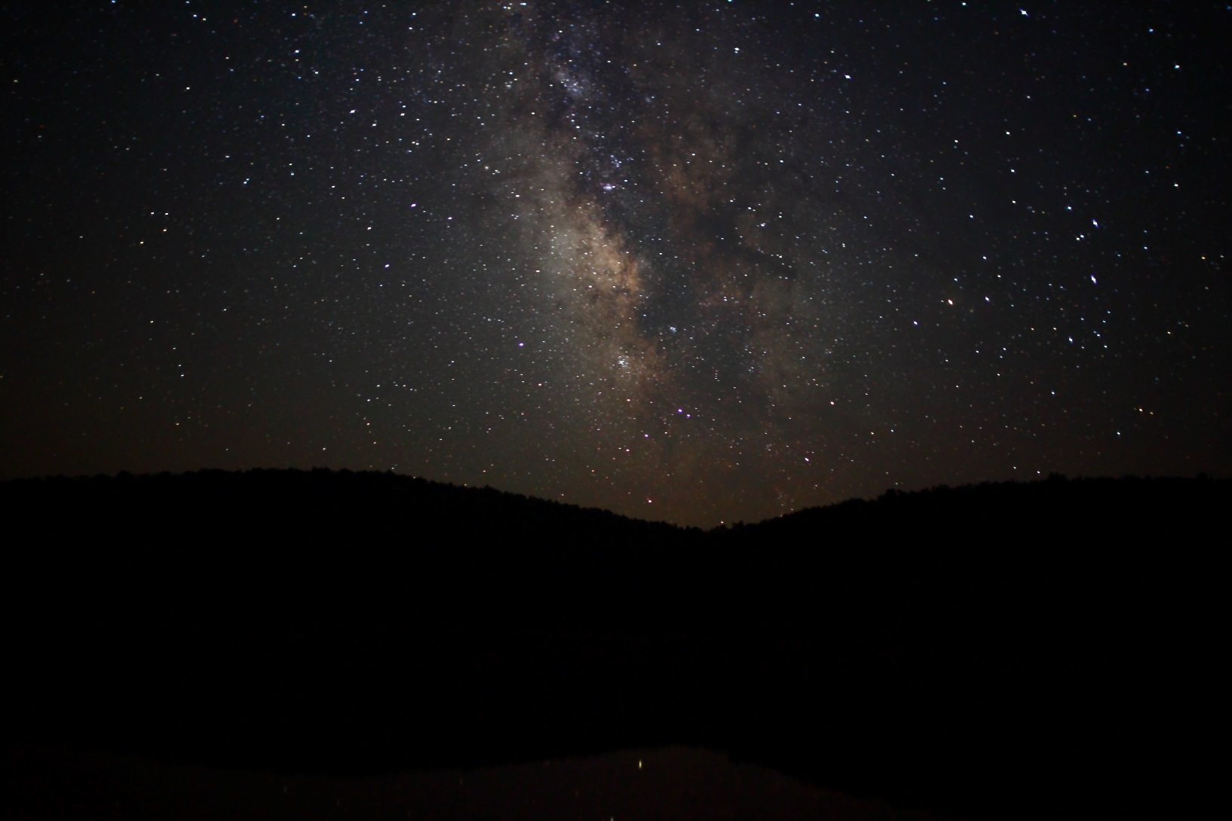
Get a minimum of 6 hours of sleep every night

Slide 22
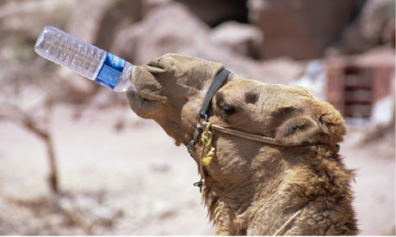
Drink more water every day
(at least 5 glasses)

Slide 23
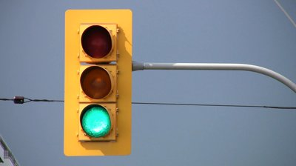
Get my N by next summer

Slide 24
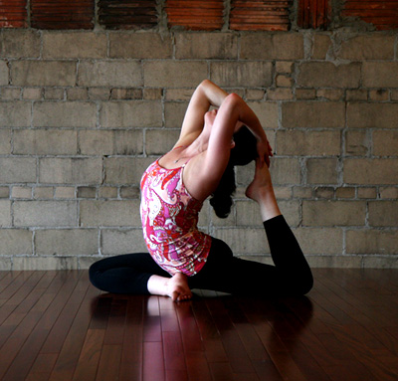
Be able to hold the pigeon pose for 10 seconds

Slide 25

Graduate (on time)

Slide 26
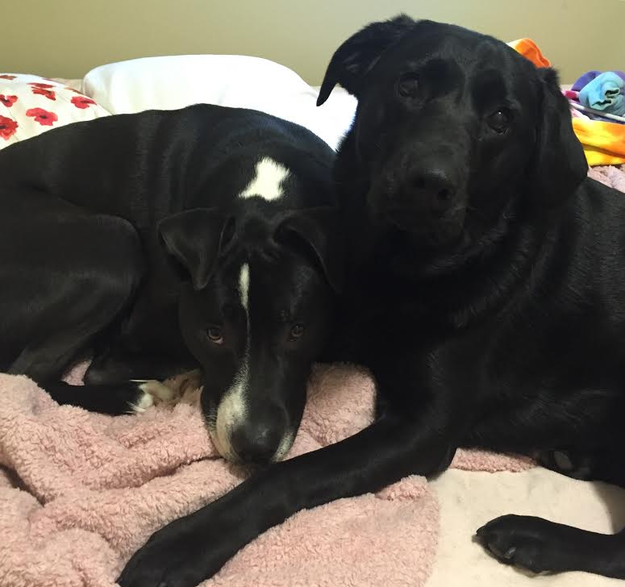
Animal: Dog

Slide 27
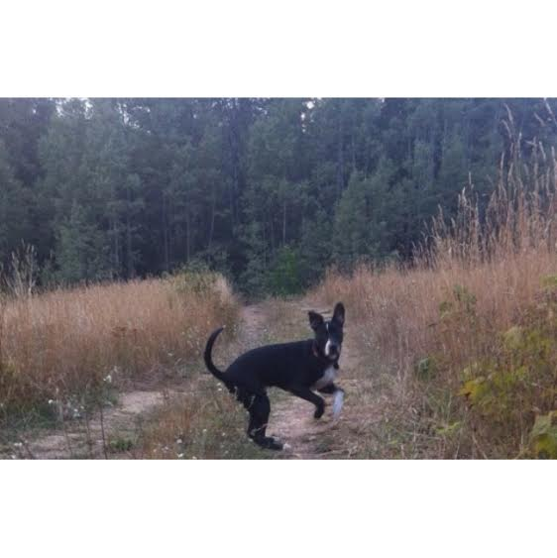
Words Describing This Animal:
Carefree
Loving
Happy

