Slide 1
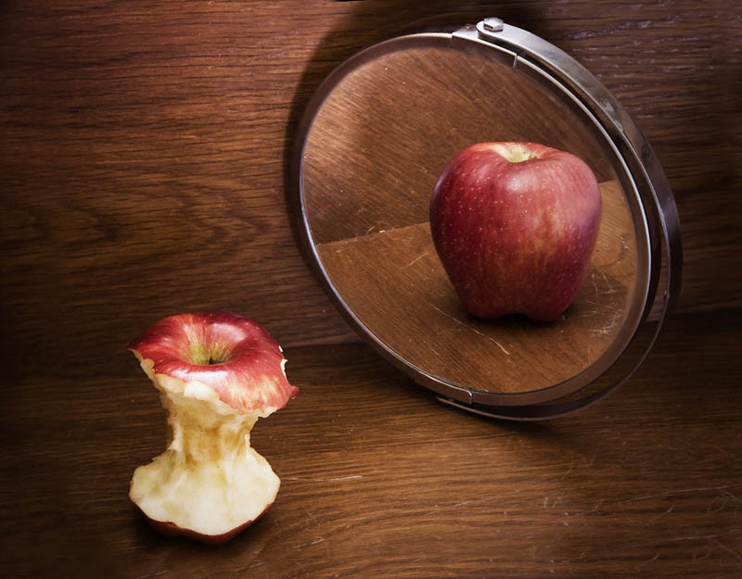
About Anorexia
(Anorexia Nervosa)

Slide 2
What is it?
An eating disorder characterized by marked weight loss and refusal to maintain a healthy weight
An eating disorder with two subtypes (purging and restrictive)

Slide 3
History
Anorexia was rare until the second half of the 20th century but was was first depicted as early as the 12th and 13th centuries (Saint Catherine of Siena starved herself as part of a spiritual ritual. The ritual was said to be a “denial of self.”)
Queen Victoria’s personal physician first coined the term “anorexia nervosa” in 1873, the term meaning “nervous absence of appetite.”

Slide 4
Who Does it Affect?
Thought to have only affected adolescent, middle-class girls, the disorder affects a far larger group
Is now known to affect males, all ages, all races / ethnic groups and people of different economic and social status
Affected males make up 5-10% of cases

Slide 5
Statistics
Affects 0.3 – 1% of population (statistics Canada)
Highest morbidity rate of any mental illness (either through suicide or health complications)
Suicide attempts in 20-30% of those diagnosed

Slide 6
Causes
Genetic predisposition, family history of AN
Environmental factors (family divorce, trouble adjusting to a new school, death of a loved one, assault)
Often accompanied by an anxiety disorder and obsessive compulsive tendencies

Slide 7
Symptoms
Weight loss (often accompanied by body dysmorphia)
Withdrawl from friends and family
depression
Decreased bone density
Lethargy
Intolerance to cold (fine, “lanugo” hairs grow over body to preserve heat)
Dizziness or fainting
Seizures
Heart problems (palpitations, irregular rhythms, stroke, heart failure)
Low blood pressure
dehydration
constipation

Slide 8
How is it Diagnosed?
The disorder can be diagnosed by either a doctor or phsychiatrist based on DSM criteria for diagnosis…
A body weight that is below what is healthy based on age / height (bmi under 18.5)
Persistent restriction of food intake
Intense fear of gaining weight or behaviour that interferes with weight gain
Disturbance in self image (believing one is fat when truly, the individual in underwight)

Slide 9
Cure / Treatment
Treatment involves supervised weight gain in conjunction with phsychological treatment
Sometimes hospitalization is required to stabilize physical health, before other treatment methods are considered
There is no specific cure, however, with treatment, 60% of patients recover and maintain a healthy body weight
The earlier a diagnosis is made, the easier it is to treat
Without treatment, 20% of sufferers die
With treatment, this number drops to 2-3%

Slide 10
Prognosis
with treatment, 60% of patients recover and maintain a healthy body weight
Without treatment, 20% of sufferers die
With treatment, 2-3% of sufferers still die
There is a 35% chance of relapse, most commonly within the first 2 years after recovery

Slide 11
How does it Impact Someone?
Infertility
Irreversible bone damage
strain on relationships
Pervasive thoughts about food
Withdrawal

